Slide 1





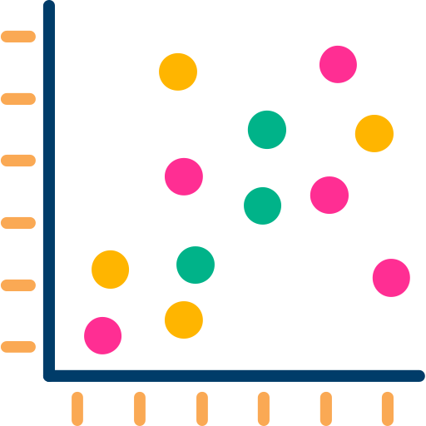











SENTIMENT ANALYSIS AND ANOMALY DETECTION ON VIETNAMESE F&B REVIEW DATA VIA FINE-TUNING PHOBERT AND ISOLATION FOREST
Nguyễn Ngọc Đông Phương
University of Information Technology, VNUHCM
What ?
Why ?
ReviewSense is an integrated system that perform three-class sentiment analysis and anomaly detection, including:
Google Maps F&B reviews in Vietnam are increasingly manipulated by seeding and boycott campaigns, severely distorting consumer information.
Proposed a method to detect anomaly in Vietnamese reviews from Google Maps
Vietnamese poses unique NLP challenges — tonal diacritics, code-switching, and F&B-specific slang — that general-purpose models consistently fail on.
Finetuned PhoBERT on a domain-specific corpus, with sentiment embedding used for anomaly detection
No prior work jointly addresses sentiment analysis and fake-review detection on Vietnamese F&B data within a single framework.
Deployed as a web app that can analyzes realtime
Overview
Data Collection & Sentiment
Feature Engineering
Anomaly Detection
Thư
2 bài đánh giá
“Ăn ổn, nhân viên thái độ với khách, không gian quán đẹp”
Time burst
Local Guide
Star differences
Text Similarity
Sentiment Similarity
{“id”:1, “text”: “Ăn ổn,...”,}
{“id”:2, “text”: “dở,...”,
{“id”:3, “text”: “ok,...”,
PhoBERT base
Description
1. Data collect & Sentiment
2. Feature Engineering
3. Anomaly Detection
Corpus of ~14,800 Vietnamese F&B reviews scraped from 93 venues across Ho Chi Minh City and Hanoi, stratified by city, business type, and star rating tier to ensure domain diversity.
PhoBERT is fine-tuned via a three-step transfer learning chain (base → Wonrax e-commerce checkpoint → ReviewSense F&B corpus), allowing the model to inherit Vietnamese consumer sentiment knowledge before domain adaptation.
Isolation Forest runs fully unsupervised with contamination = 0.1, reflecting the estimated seeding rate in the F&B industry from prior empirical studies.
Annotation follows a Teacher-Student strategy: 1,000 gold labels by human experts + 13,486 silver labels by GPT-4.1 mini, with predictions below 0.75 confidence discarded.
Two detection variants are compared — A1 (behavioral only) and A2 (behavioral + semantic) — with Jaccard similarity confirming they capture complementary anomaly patterns, A2 catching sophisticated seeding that A1 misses.
Nine features are fused into a single vector: 6 behavioral (rating, time burst, account age, review length, Local Guide status, star deviation) and 3 PhoBERT-derived semantic features (template language score, sentiment coherence, text similarity).
A1
A2
Nguyễn Ngọc Đông Phương – Trường Đại học Công Nghệ Thông Tin
TEL : 0962306647 Email : phuongdong2262@gmail.com
Notes:
‹#›

